Slide 1

HPS
TEAM 8

Slide 2
ootd
#
HPS
TEAM 8

Slide 3
ootd
#
G
le

Slide 4
Gootdle

Slide 5
Smart dressing, zero messing
Gootdle

Slide 6
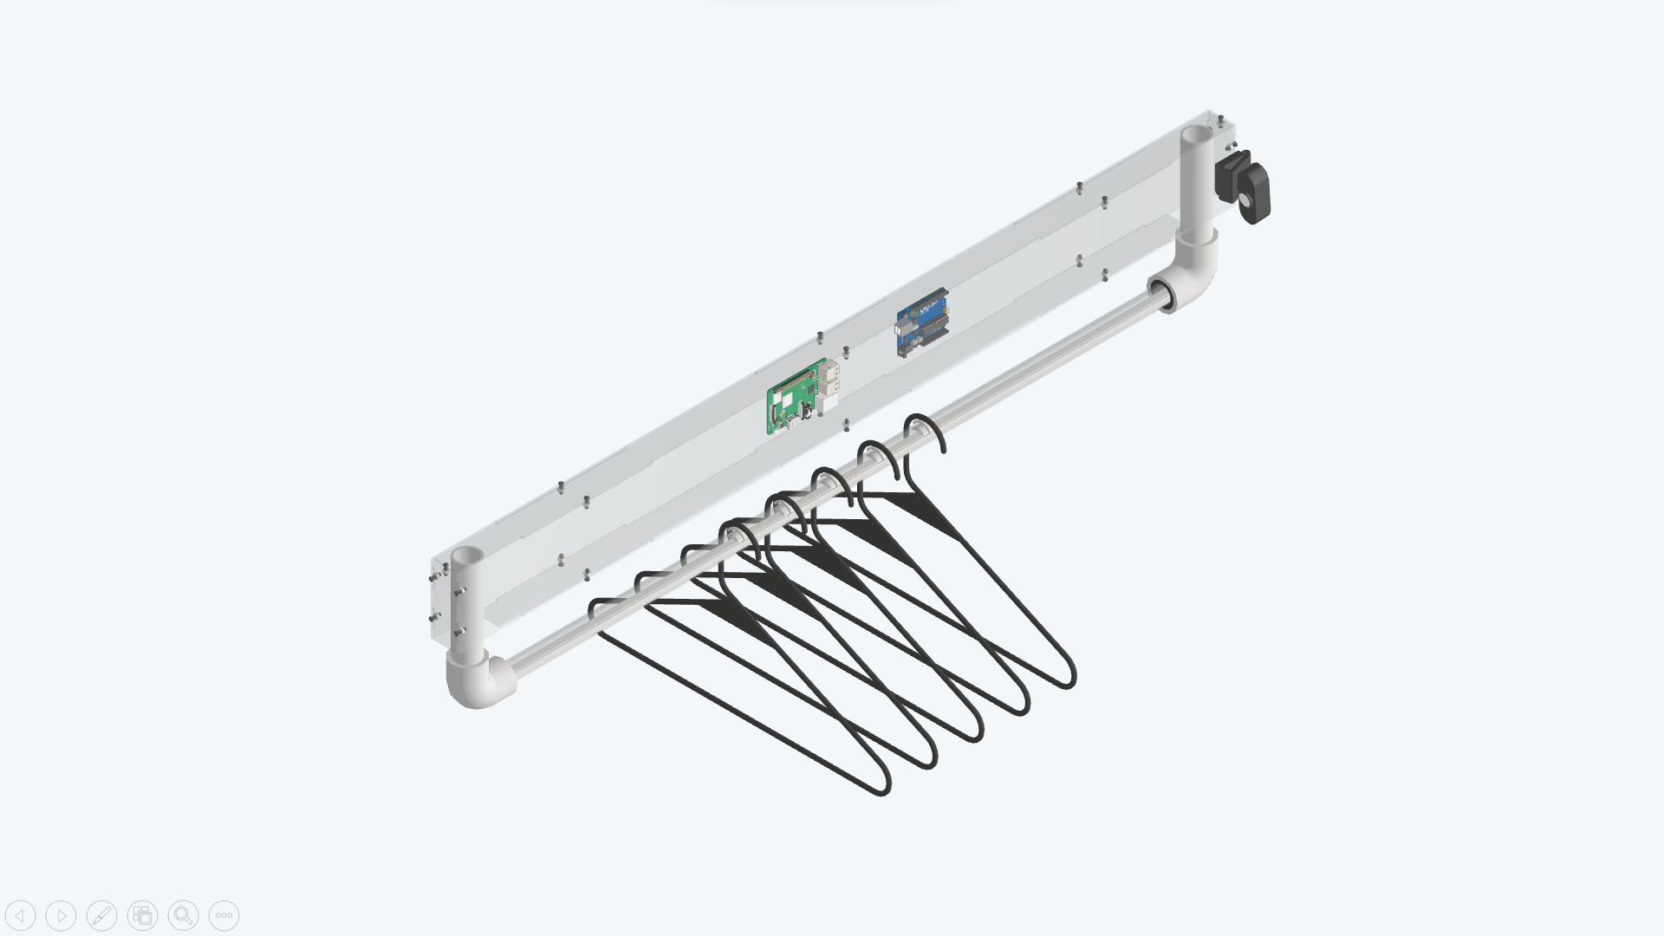

Gootdle

Slide 7
Camera
Raspberry pi
Used CV to identify what
cloth you are holding.
Communicated with
Backend server.
Arduino
Controlled LEDs and sended signals to Raspberry pi.
Force Sensing Elements
Located the clothes hung on clothing rail.
Gootdle

Slide 8
Camera
Raspberry pi
Used CV to identify what
cloth you are holding.
Communicated with
Backend server.
Arduino
Controlled LEDs and sended signals to Raspberry pi.
Force Sensing Elements
Located the clothes hung on clothing rail.
Gootdle

Slide 9
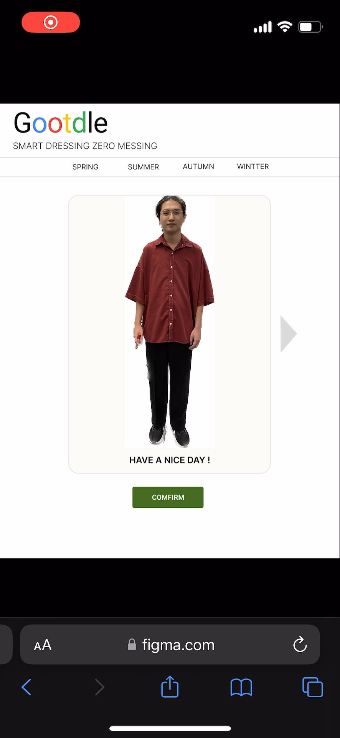
Clothes Recommandation
Find the perfect style for
you.
Gootdle

Slide 10
Clothes Recommandation
Find the perfect style for
you.
Gootdle

Slide 11
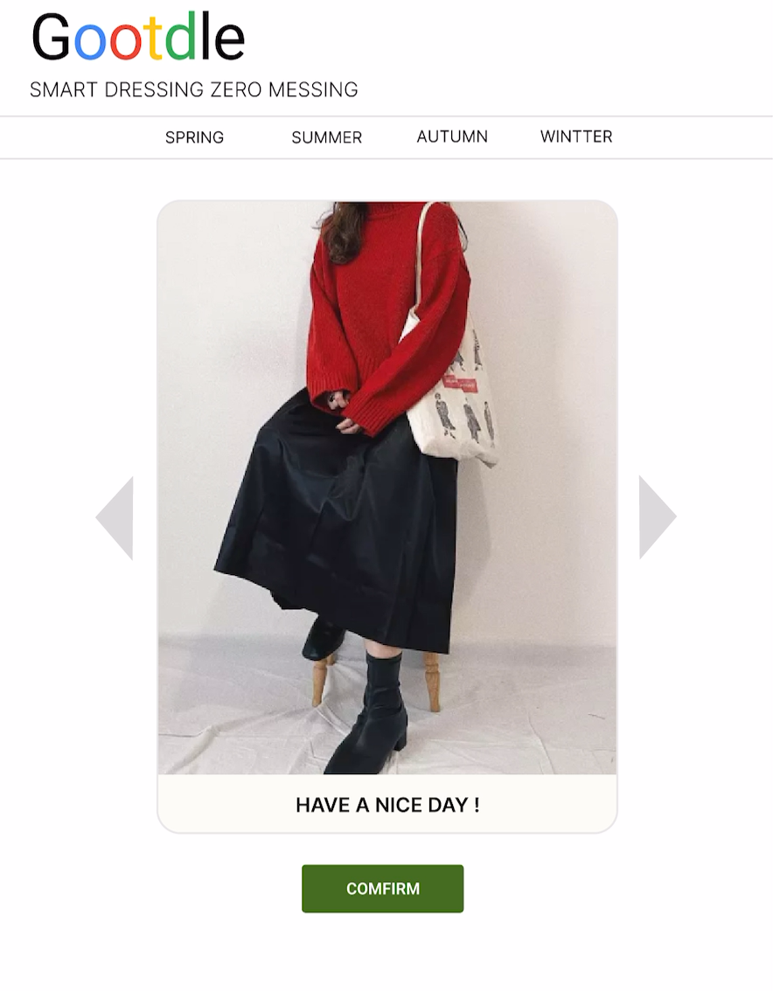
Clothes Recommandation
Find the perfect style for
you.
Gootdle

Slide 12
Gootdle

Slide 13
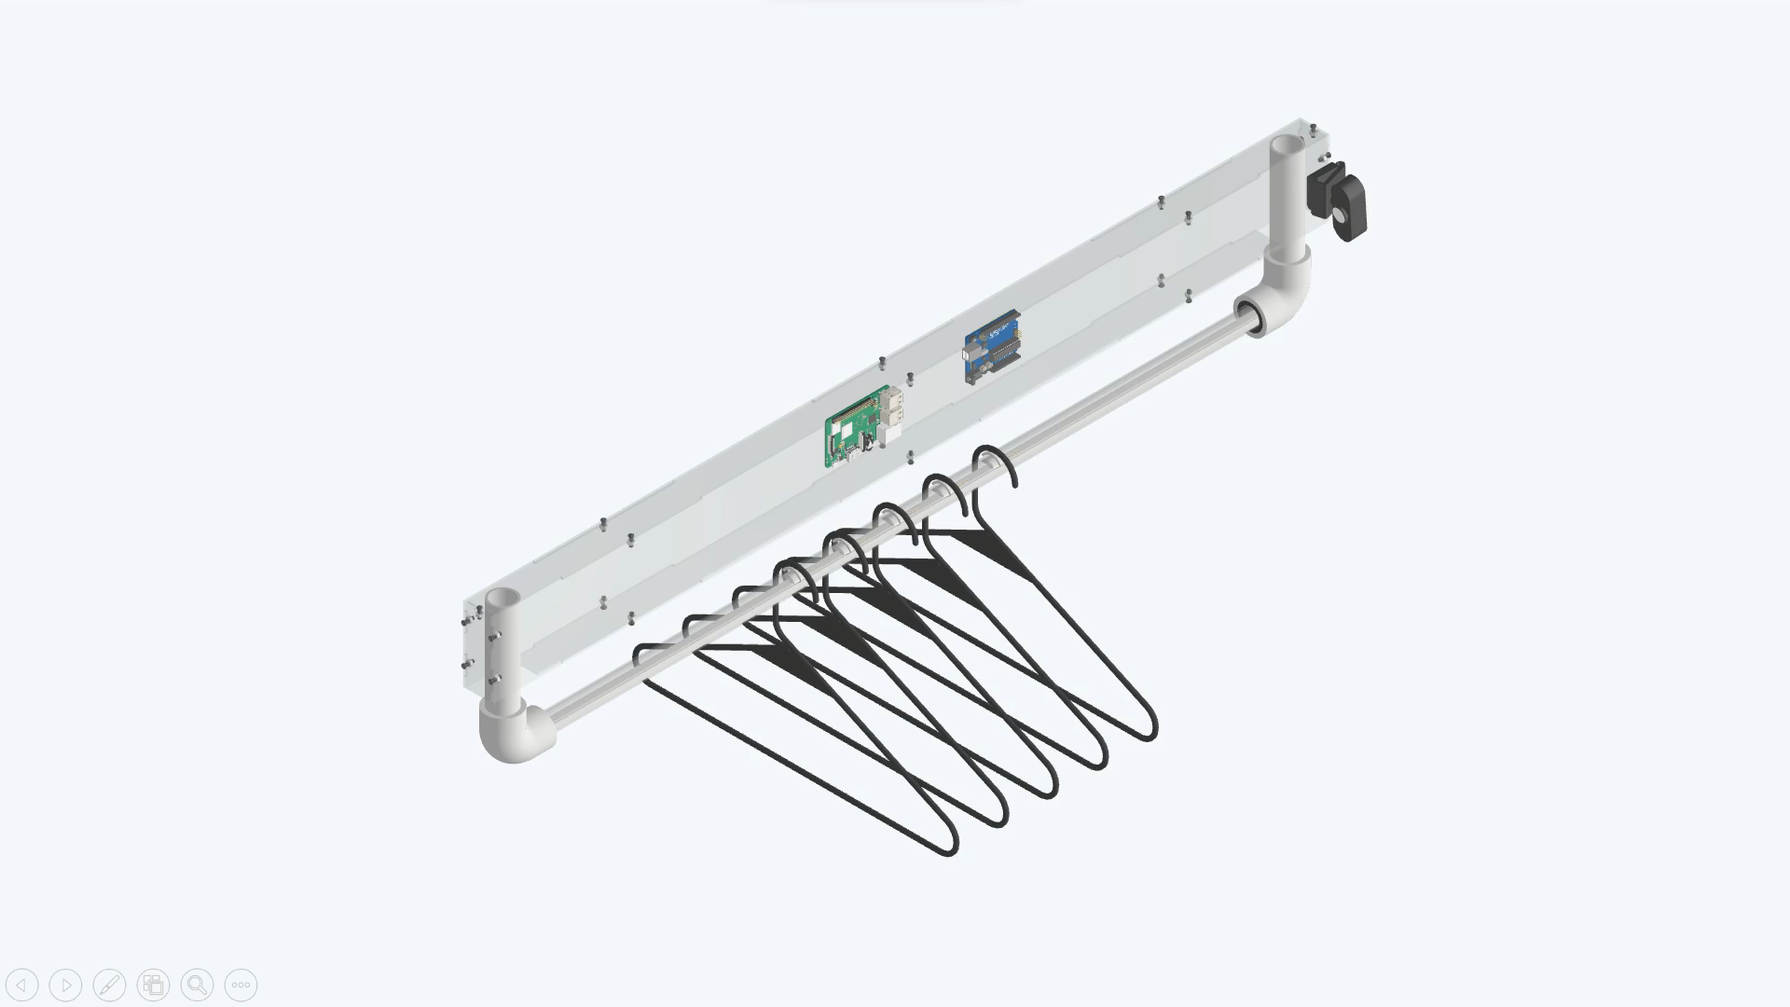
Gootdle

Slide 14
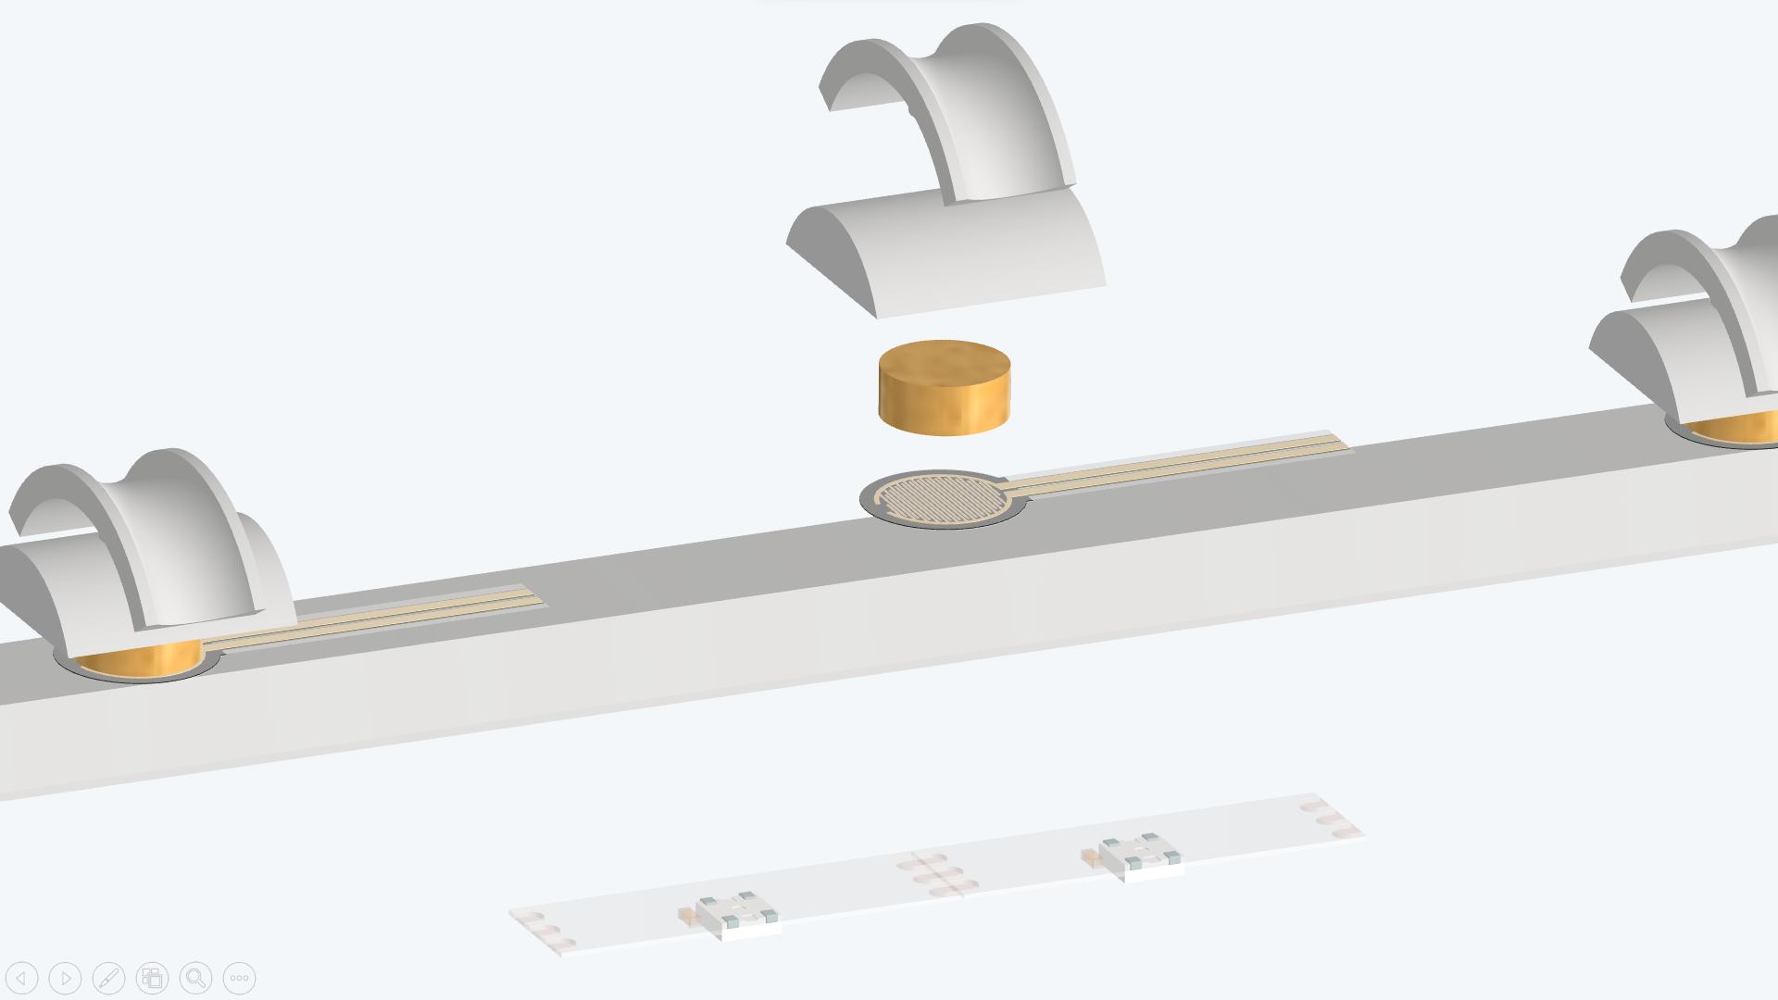
Gootdle

Slide 15
Slot
Hard Cushion
Soft Cushion
Force Sensor
WS2812 LED
Gootdle

Slide 16
Gootdle
Smart dressing, zero messing

Slide 17

Persona
Name：Elena
Location：Taipei
Age：25
MBTI：INTP
Occupation：Silicon Engineer
Hobby：Photography
Salary：90k
Hope：Improve self-confidence

Slide 18


Personal
Commercial
Age：25 – 40
Salary：45k up
Occupation：white - collar worker、KOL
Demand： outfit recommendations 、
a lot of clothes lacking proper organization
Scale：SME、large enterprise
Industry：service industry
Types：clothing boutiques、bridal shops
Demand： provide virtual try - on service、commodity and clothing organization

Slide 19


市場規模
TAIWAN
KOREA
6.82 million people
30 million people
Middle to upper-class working professionals with fashion needs
TAM
3.61 million people
22 million people
Clothing Boutiques, Bridal Shops, and Working Professionals Looking to Enhance Their Dressing Experience
SAM
490,000 people
10 million people
According to the market research results
the proportion of people interested in the product
Based on market research results in Taiwan
SOM
Notes:
1.Demo
Design
Cad
2.先臺灣後日本，拐杖銷售額
上班族 平日上班

Slide 20
市場規模
TAIWAN
6.82 million people
Middle to upper-class working professionals with fashion needs
TAM
3.61 million people
Clothing Boutiques, Bridal Shops, and Working Professionals Looking to Enhance Their Dressing Experience
SAM
490,000 people
SOM
According to the market research results the proportion of people interested in the product
Notes:
1.Demo
Design
Cad
2.先臺灣後日本，拐杖銷售額
上班族 平日上班

Slide 21
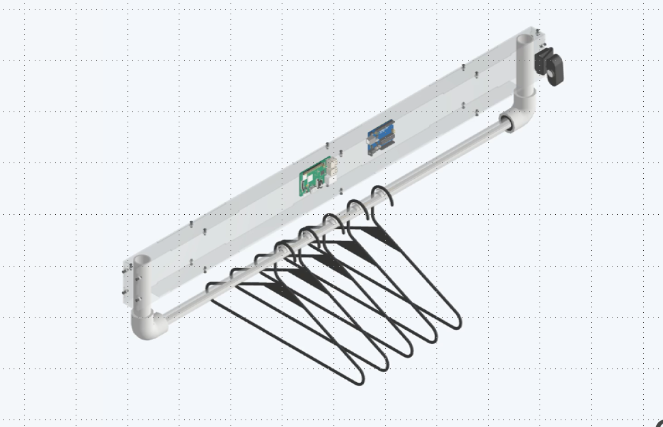
產品定價
Operating Costs
12100
Others
3000
Webcam
Acrylic Shell
Raspberry Pi
Pressure Sensor
(Number of Hangers)
PVC Pipe
Spray Paint
Wiring
4000
2000
2000
300*5
300
200
100
Other Materials
Research and Development Costs
1000
2000
Price
NT 32,700 ～ NT 38,150
Notes:
壓2000
線材 100
壓力感測器 300
樹梅派 2000
Webcame 4000
噴漆 200
pvc水管 300
衣架

Slide 22
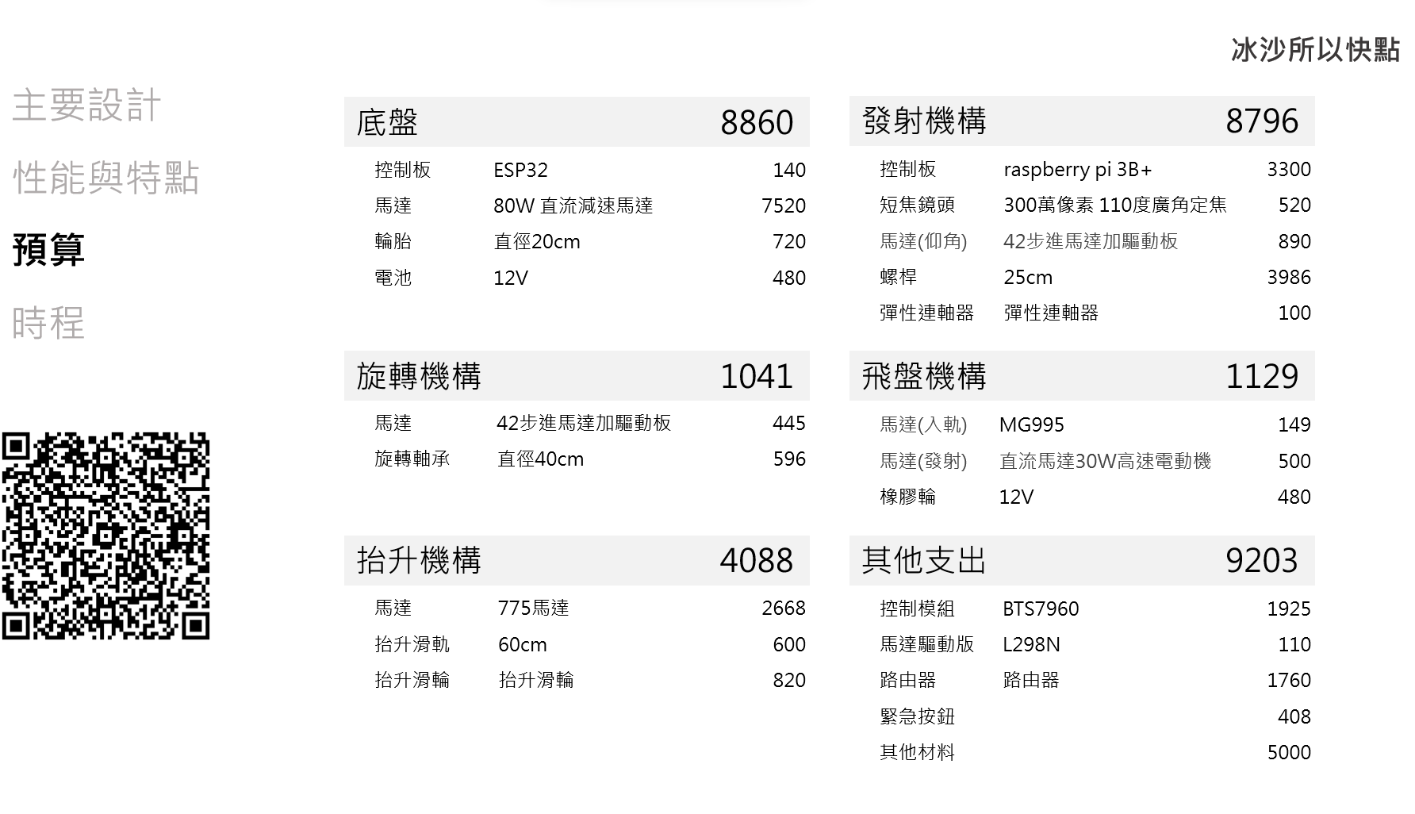

Slide 23
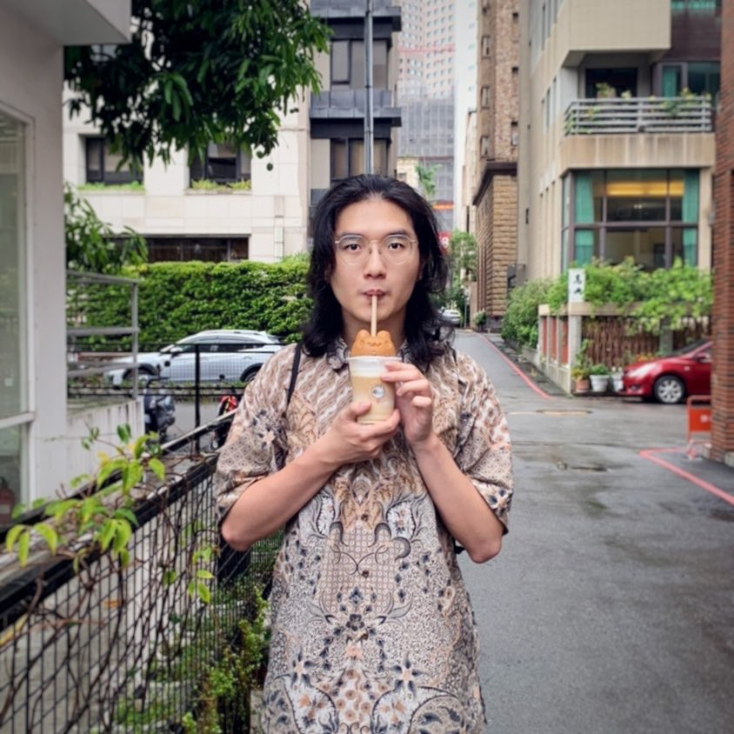
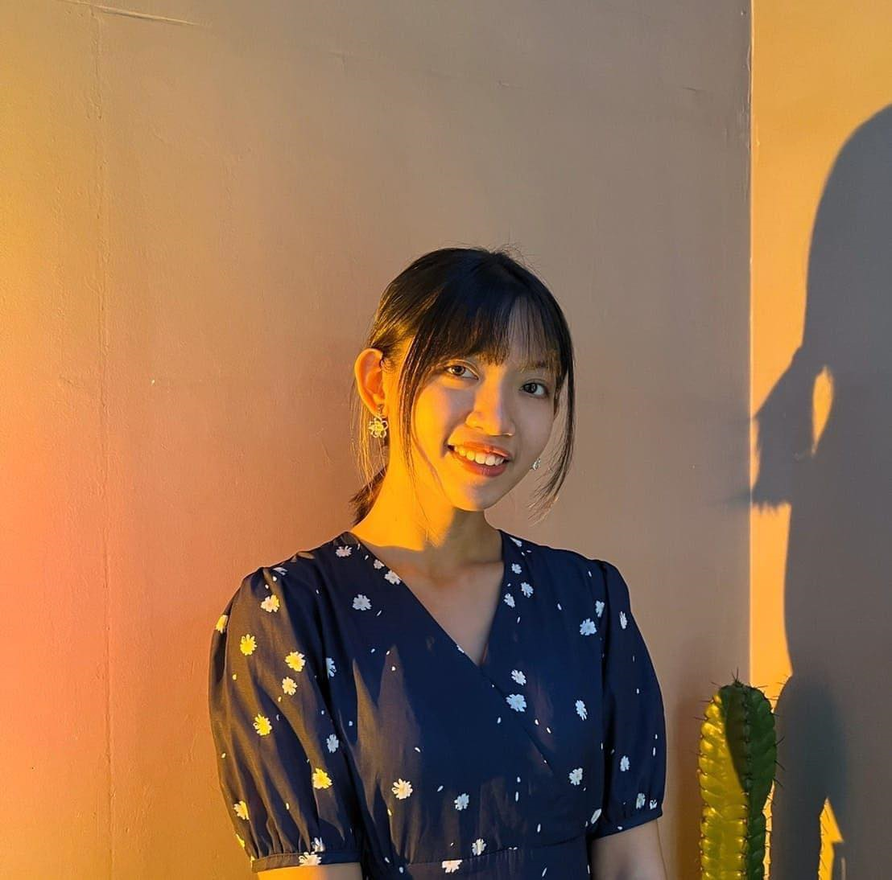
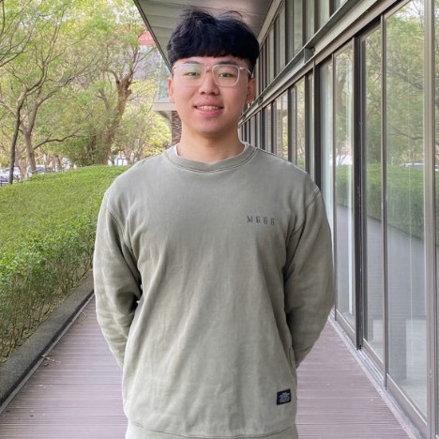
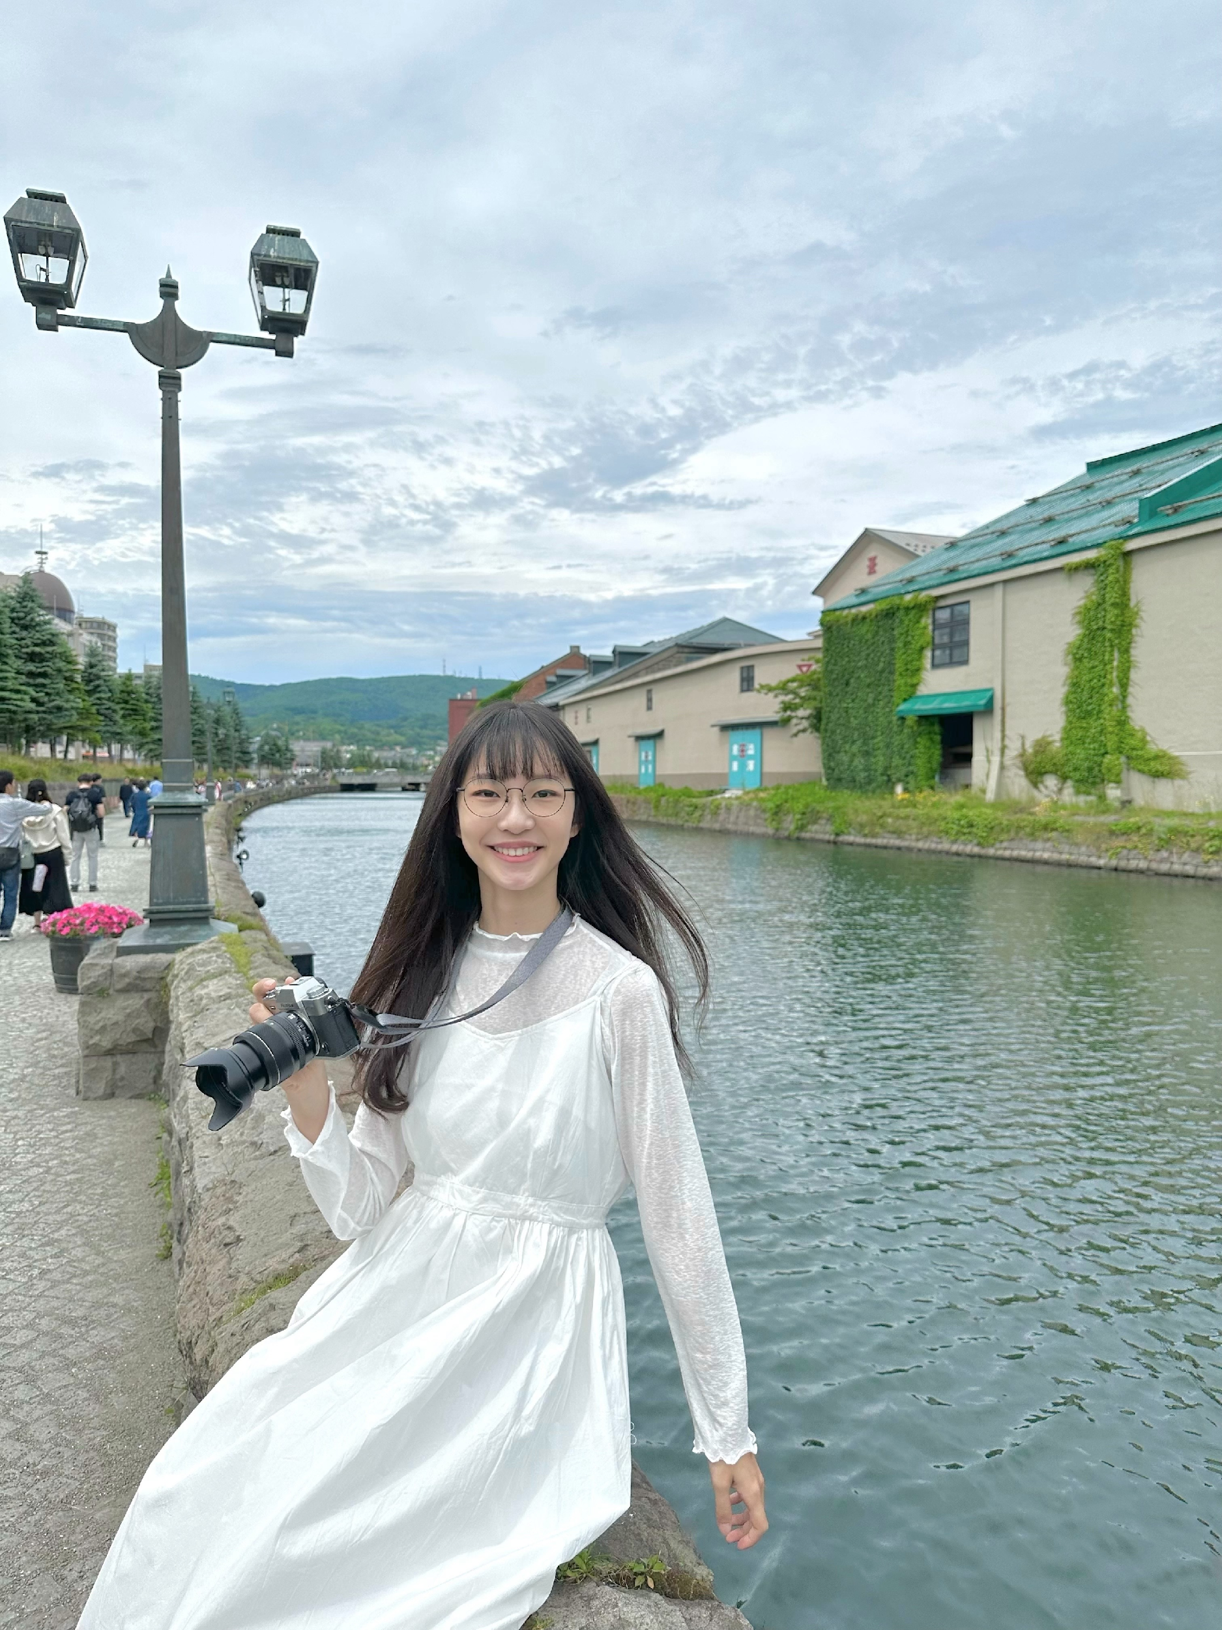
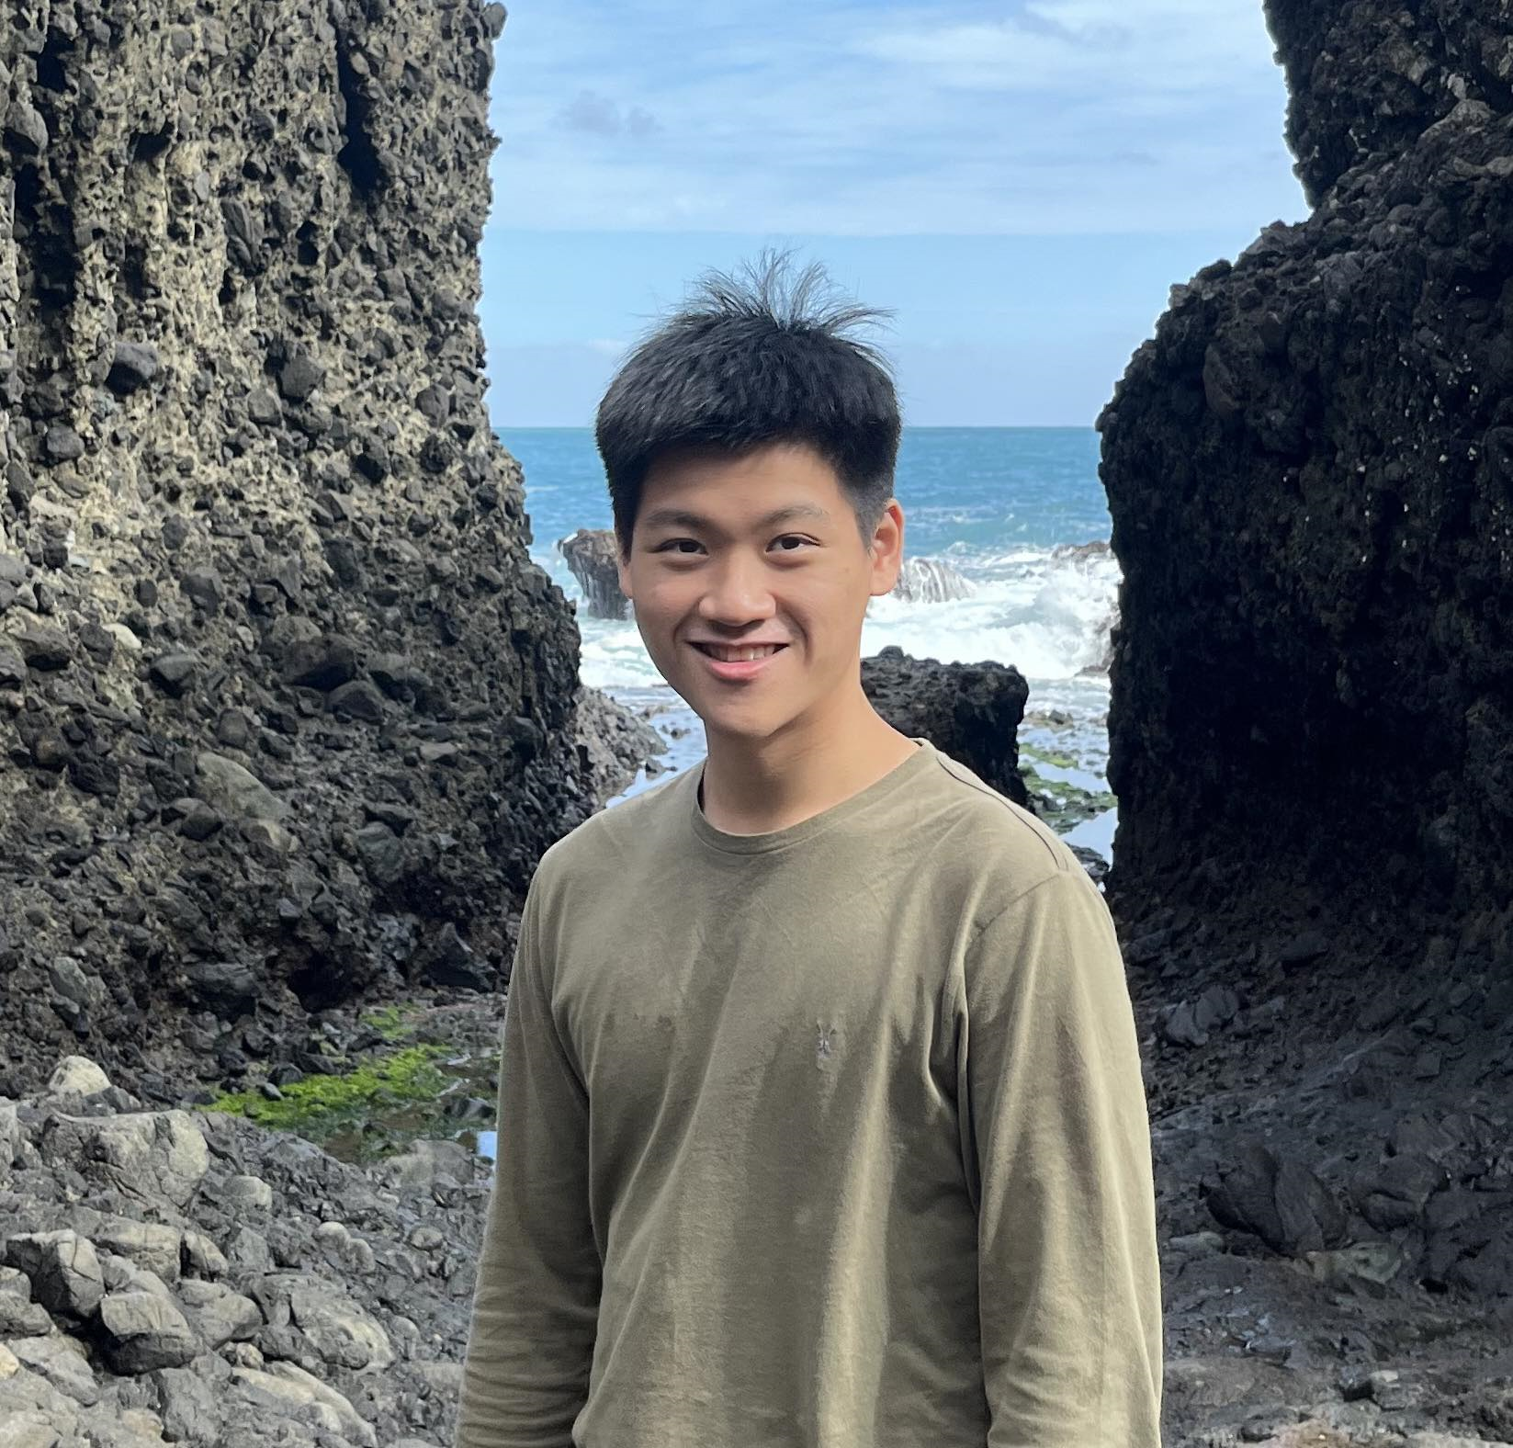
DB Events
Database
Web Server
Andrew
Web Cam
Raspberry Pi
Backend
Frontend
Arduino
Serial
Mac
Computer
Vision
Penny
Mechanism
Force Sensor
LED
Laser Cutting
3D Printing
Max
Yushan
Marshall

